Slide 1
Getting Help
This section provides you with instructions on how to get help and report problems.

Slide 2
Help Resources
Runtime resources
  --help, --modhelp module[:class]
Troubleshooting page
  Documents warning and error messages
SF Wiki
  Latest documentation
  Searchable and you can make edits
SF Forums
  Questions not covered by Wiki
  All users see answer
SF user emails
  Ok, but not always as quick
  Other users don’t benefit from answer
SF TRAC
  Used if none of the above addresses the problem
  Used to report “bugs” or requested upgrades

Slide 3
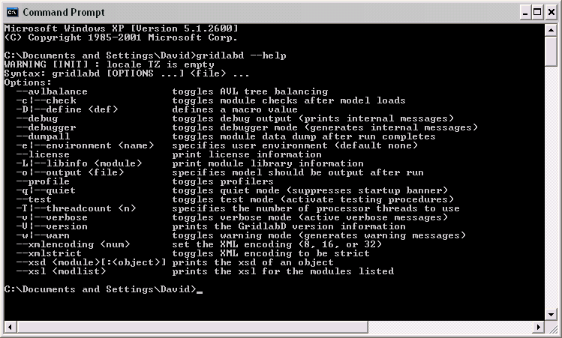
Example: --help option

Slide 4
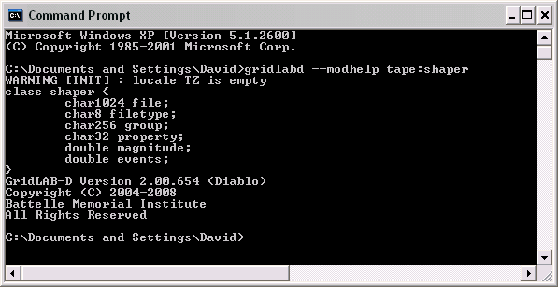
Example: --modhelp tape:shaper

Slide 5
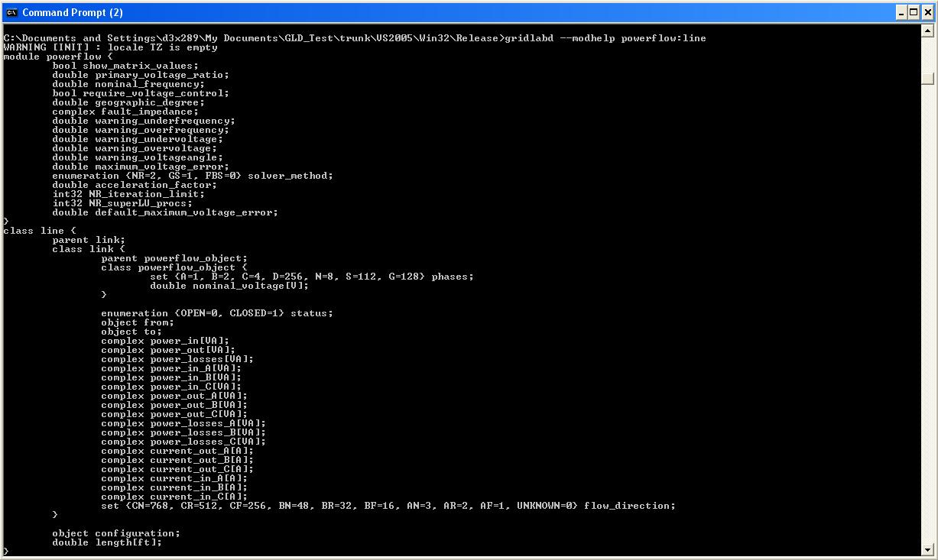
Example: --modhelp powerflow:line
Notes:
What is the purpose of this slide?

Slide 6
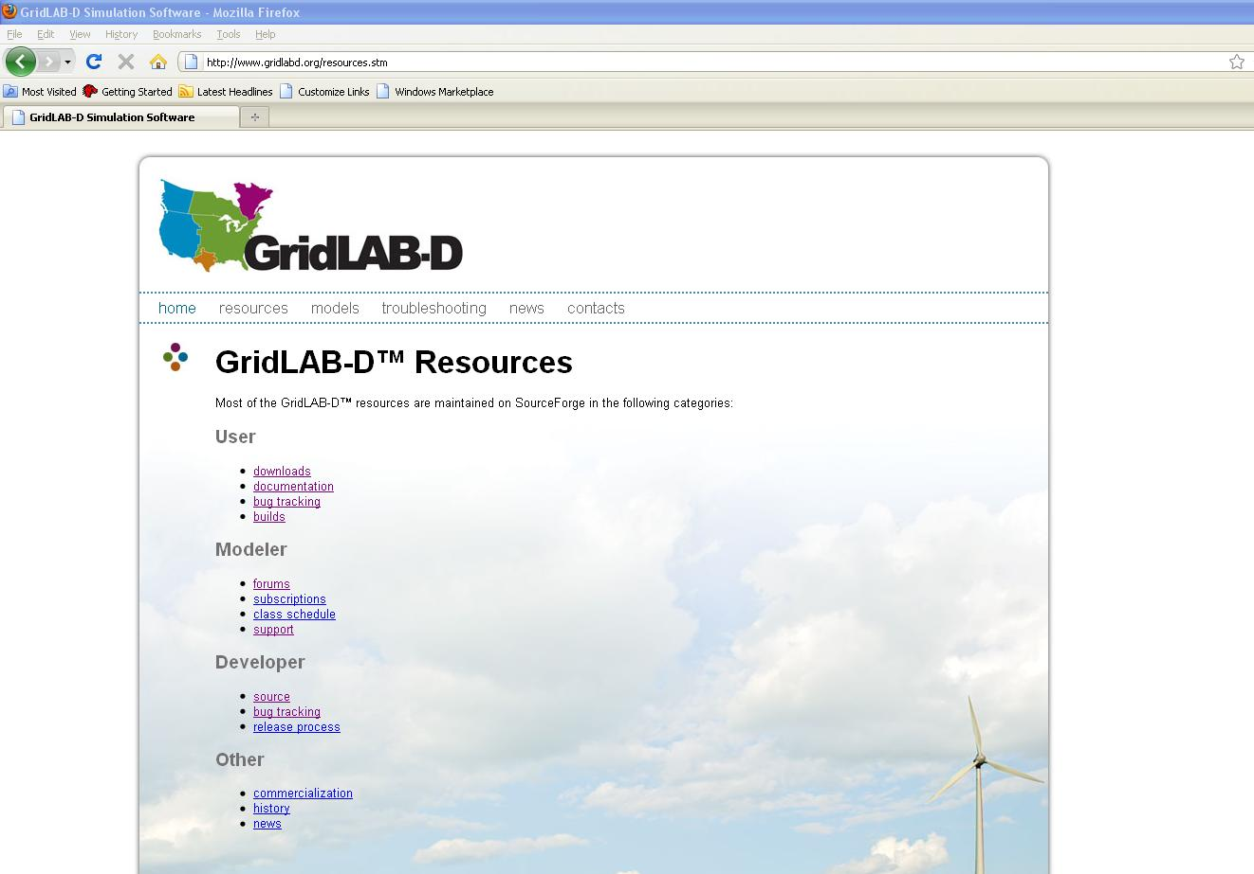

Slide 7
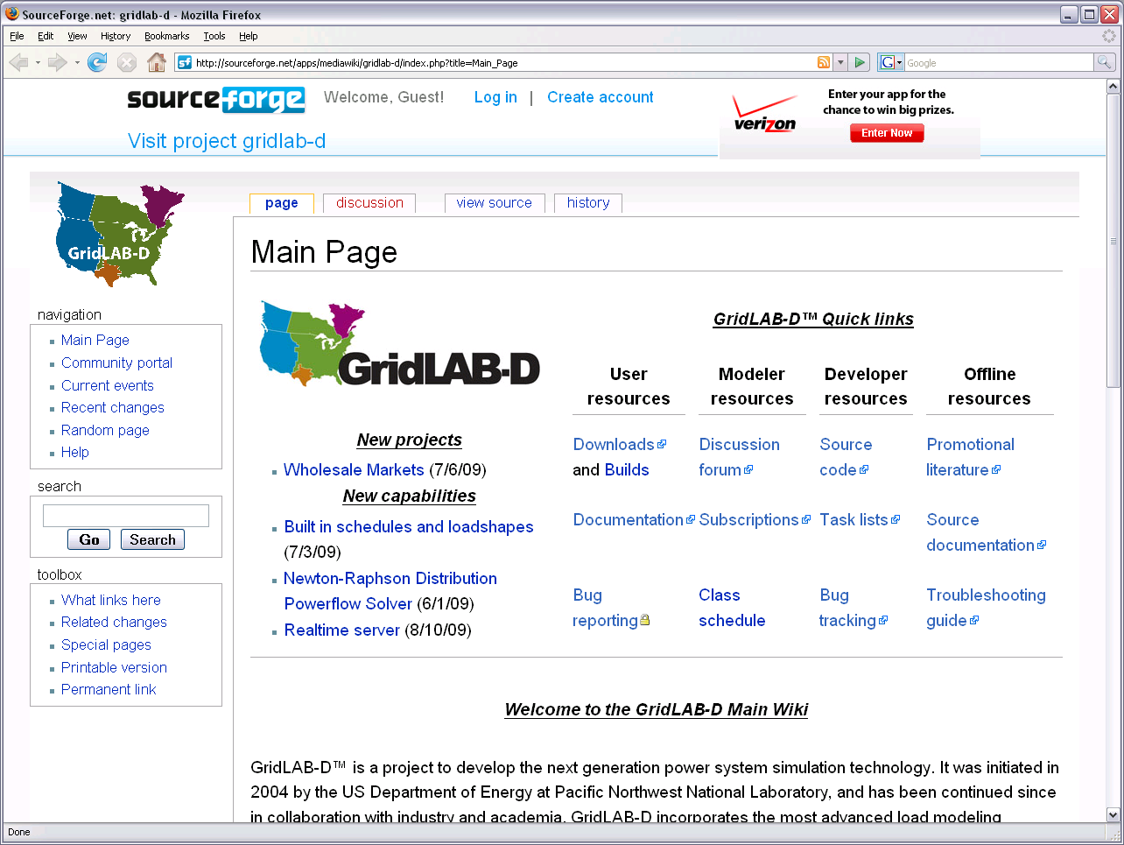

Slide 8
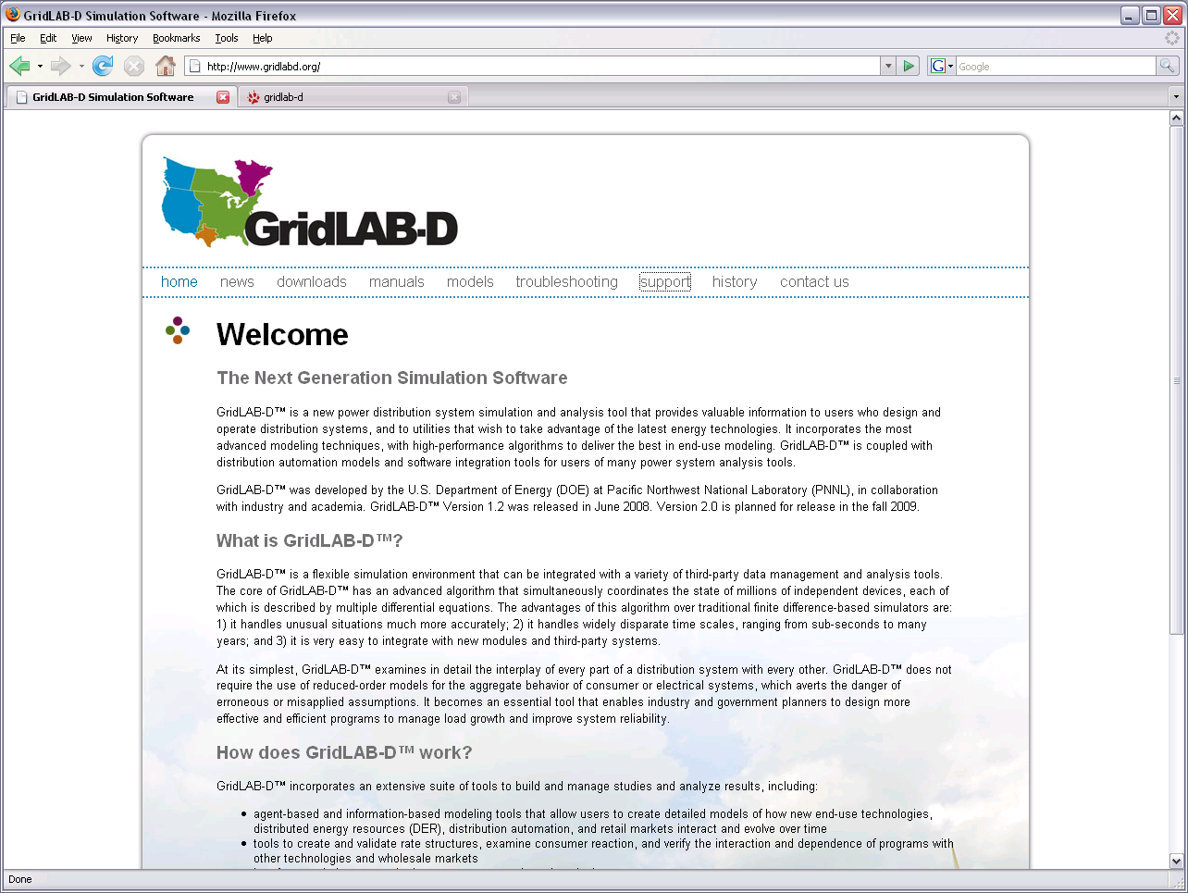

Slide 9
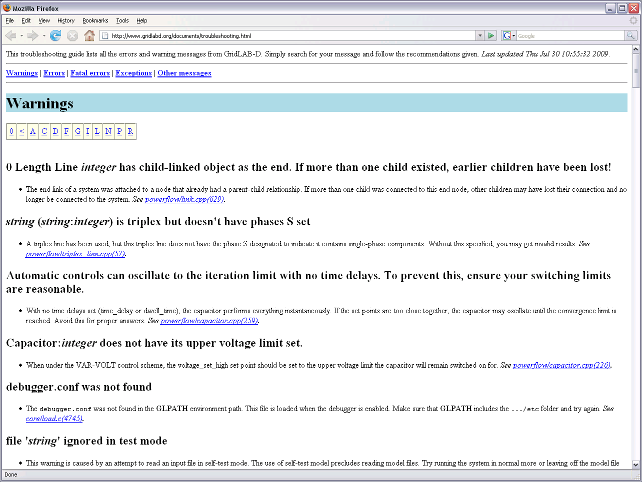

Slide 10
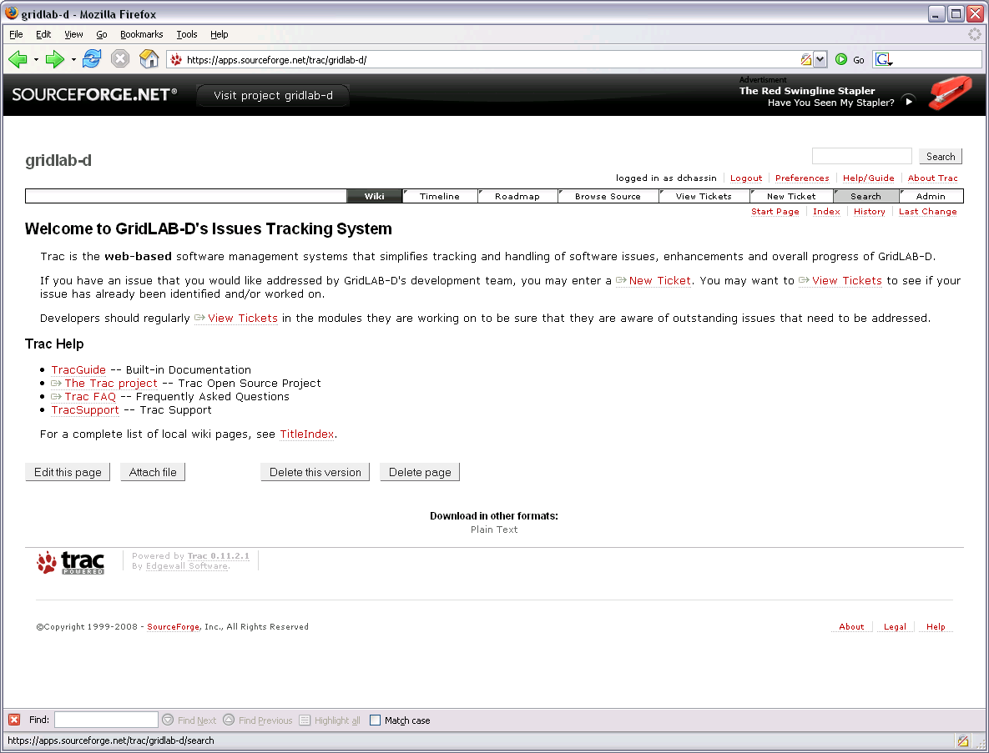

Slide 11
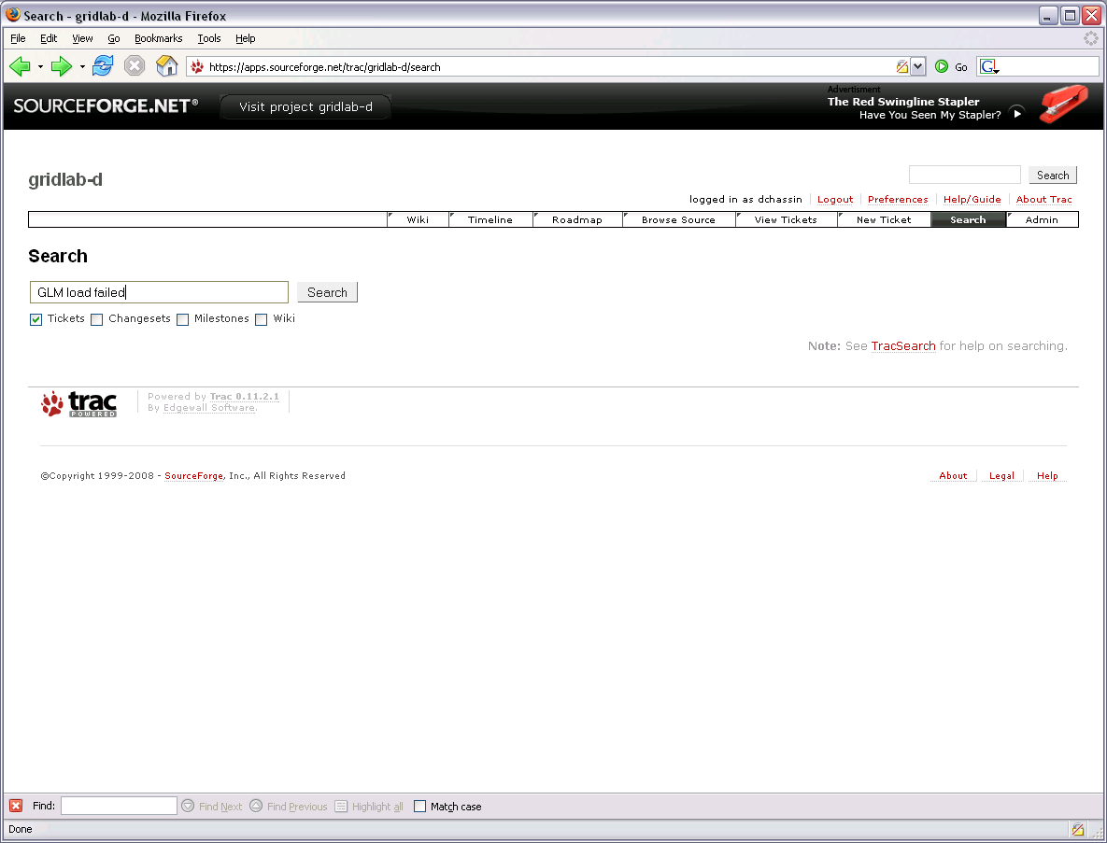

Slide 12
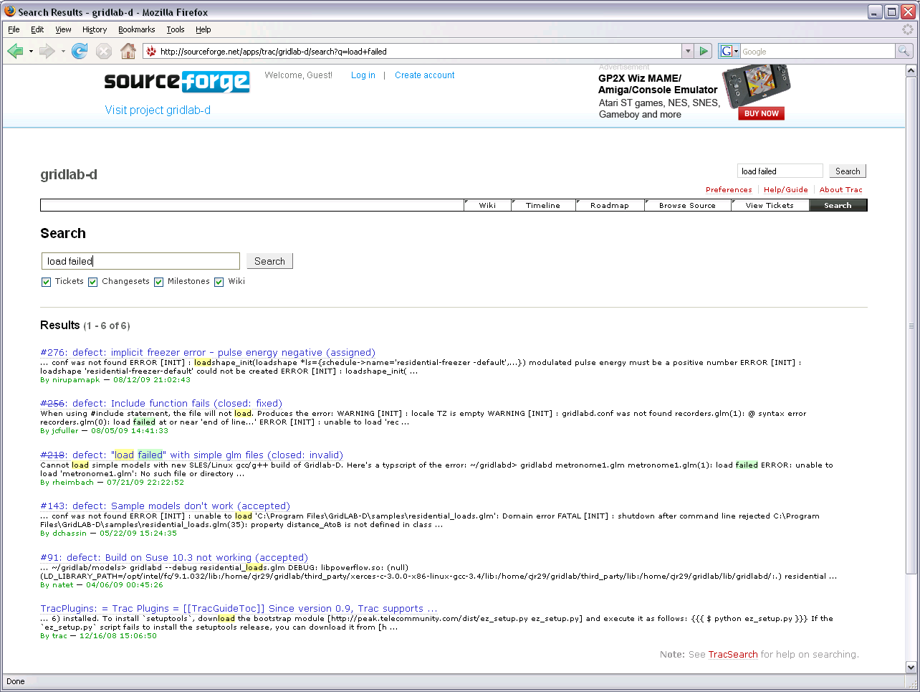

Slide 13
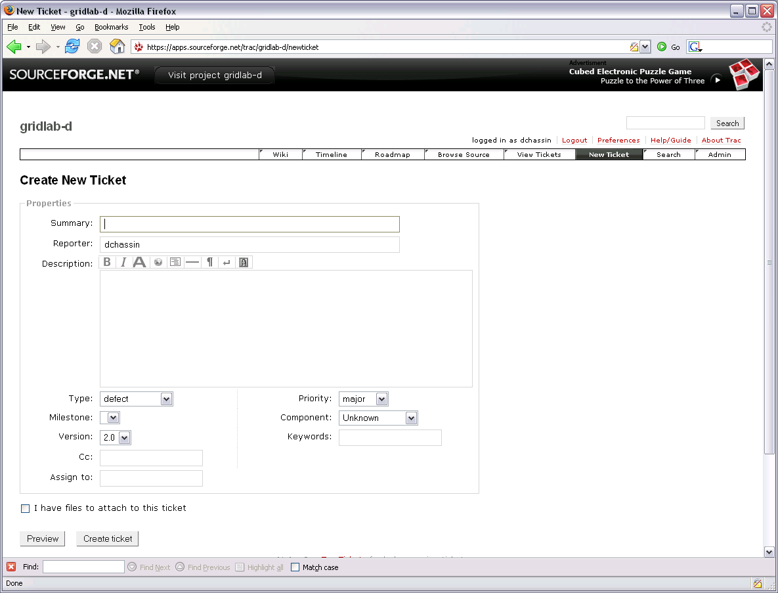

Slide 14
Reporting problems
SF TRAC system
  Routes and tracks problems/solutions/fixes
Tips for effective bug reporting
  Make sure you search wikis and forums first
  Reduce problem to simple example
  Post the example with the report
  Log in so we can contact you when it’s solved

Slide 16
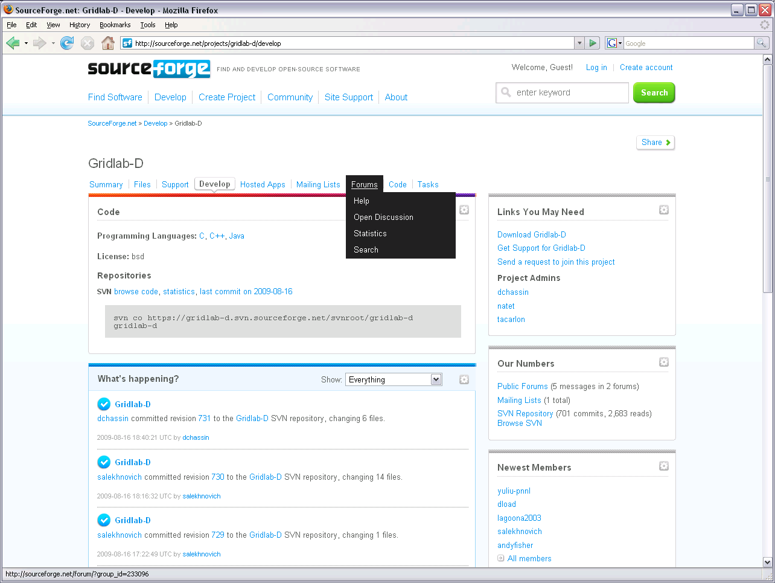

Slide 17
Exercises 1.3
How would you get more information from the command prompt ?
You found a problem where F4 doesn’t work when the #error macro is used. Search TRAC for similar reports.
Find the MediaWiki page for Gridlab-D and look up the users guide for Residential Module.
Name a property of the object freezer?
Notes:
First and third question do not pertain to this lesson?

